Slide 1


Quick Guide
NEXCORE UML Modeler
(Apache License Version)
Installation
Run
SK Holdings

Slide 2
Installation

Slide 3
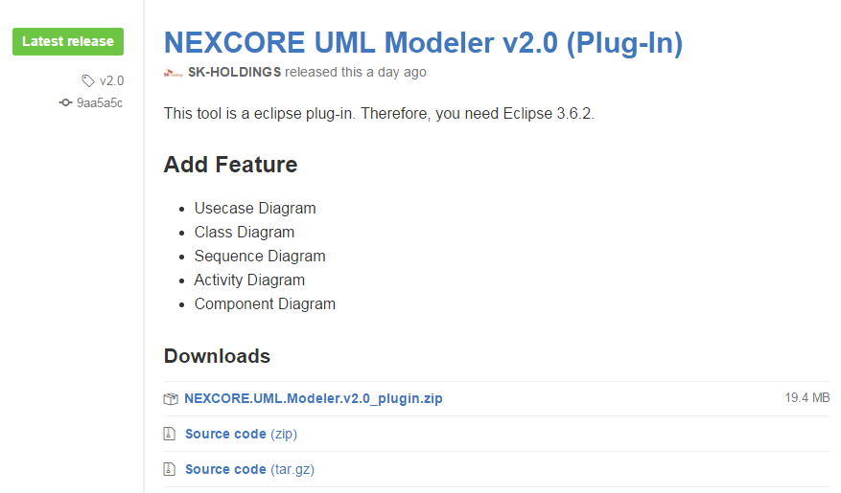
Download NEXCORE UML Modeler
플러그인 다운로드 :
https://github.com/SK-HOLDINGS-CC/NEXCORE-UML-Modeler/releases
download

Slide 4
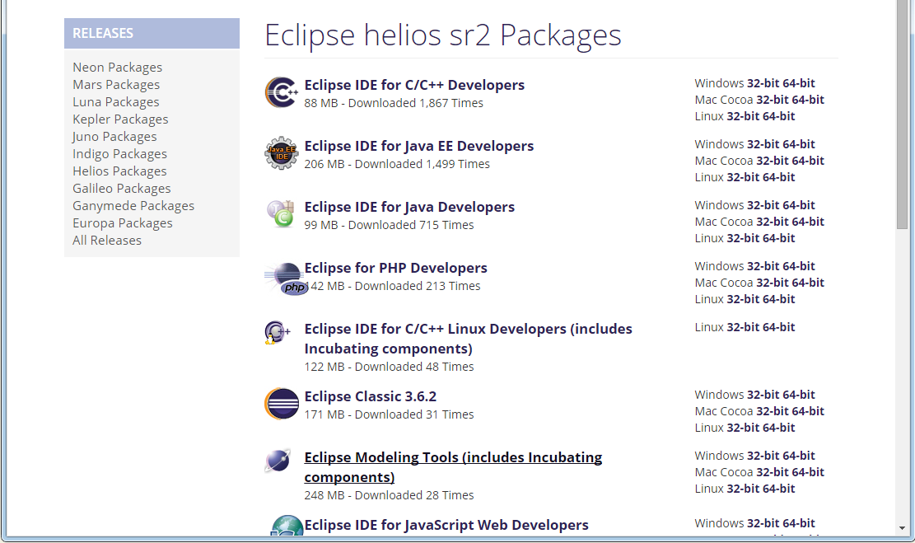
Download Eclipse Modeling Tools
Eclipse : v3.6.2(Eclipse helios sr2 - Eclipse Modeling Tools)
EMF – Eclipse Modeling Framework SDK v2.6.1
GEF – Graphical Edition Framework GEF SDK v3.6.2
UML2 Extender SDK v3.1.2
다운로드 : http://www.eclipse.org/downloads/packages/release/helios/sr2

Slide 5
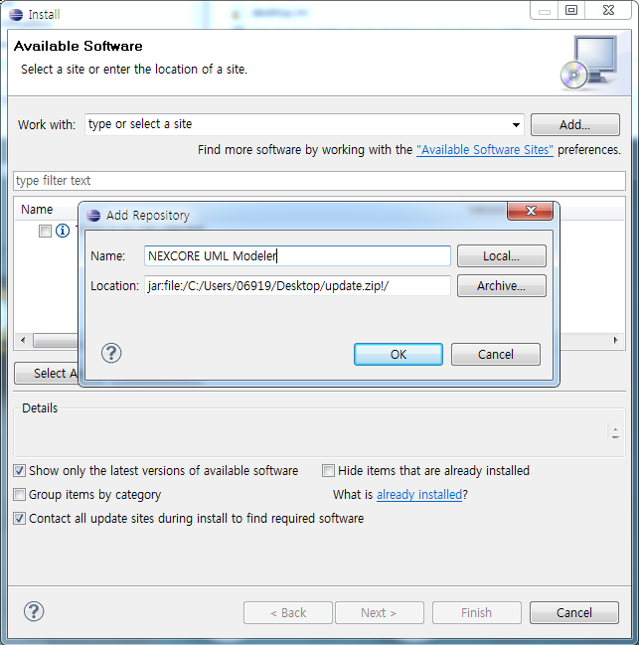
Install Plug-In of NEXCORE UML Modeler (1/3)
플러그인 업데이트 : 이클립스 실행 > Help 메뉴 > Install New Software…
1. 클릭
4. 입력
2. 클릭
3. 파일 선택
NEXCORE UML Modeler_PlugIn.zip
5. 클릭
6. 체크해제

Slide 6
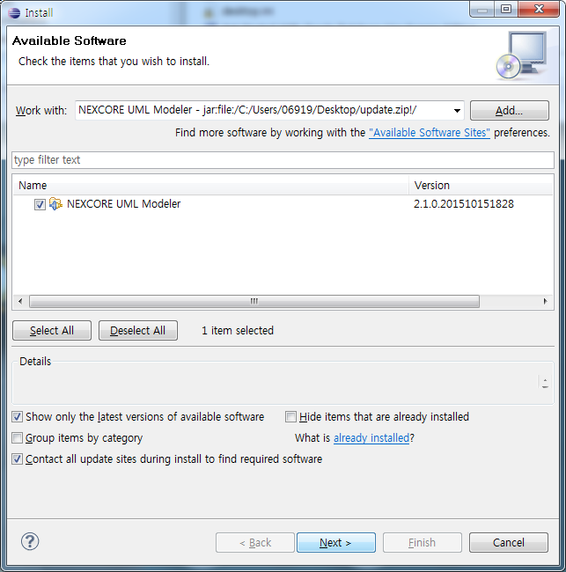
Install Plug-In of NEXCORE UML Modeler (2/3)
2. 체크
1. 체크해제 확인
3. 클릭

Slide 7
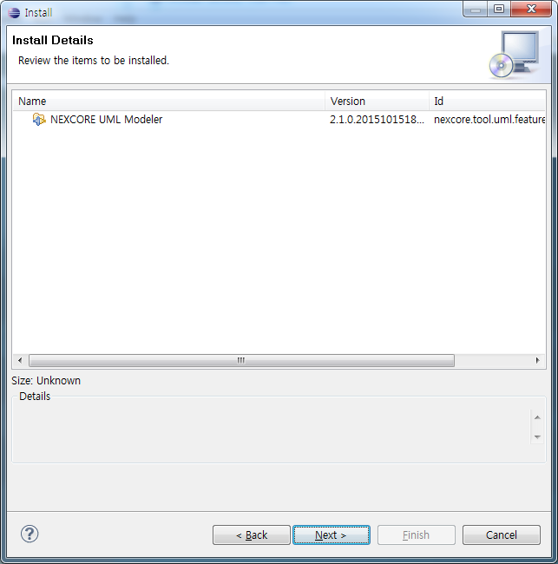
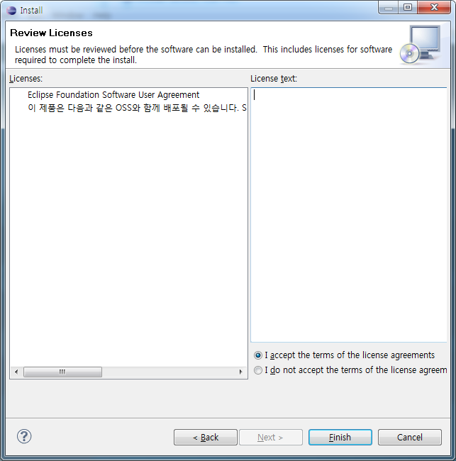
Install Plug-In of NEXCORE UML Modeler (3/3)
1. 클릭
2. 클릭
3. 클릭

Slide 8
Run

Slide 9
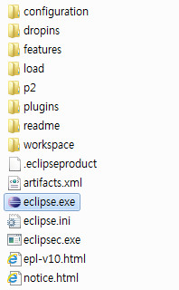
Run UML Modeler
run

Slide 10
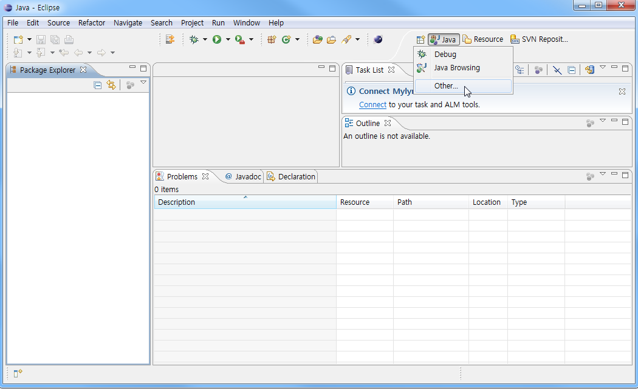
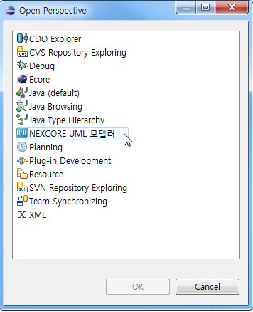
Open Perspective of UML Modeler
1.Open
Perspective
2.Other …
3. Select
UML Modeler

Slide 11
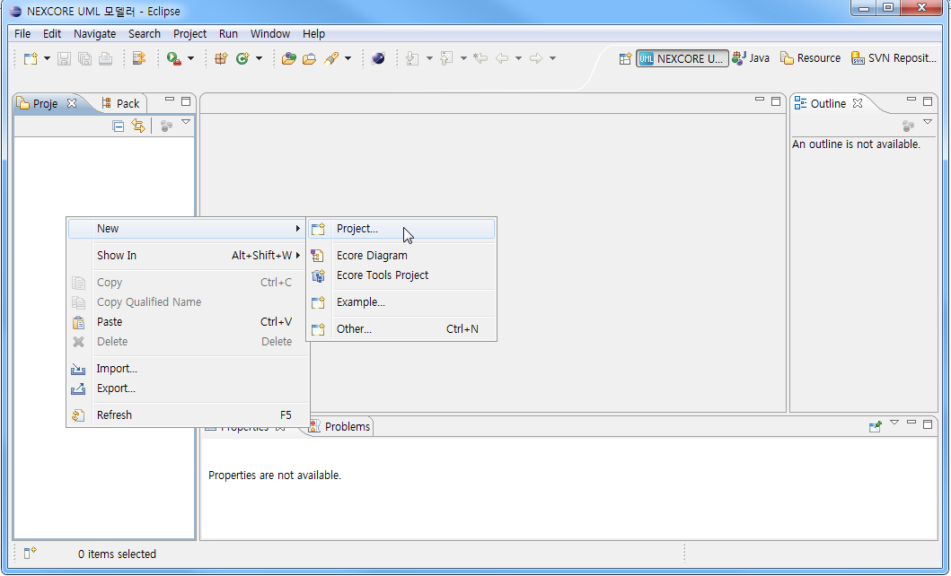
Create UML Project (1/3)
Right-Click

Slide 12
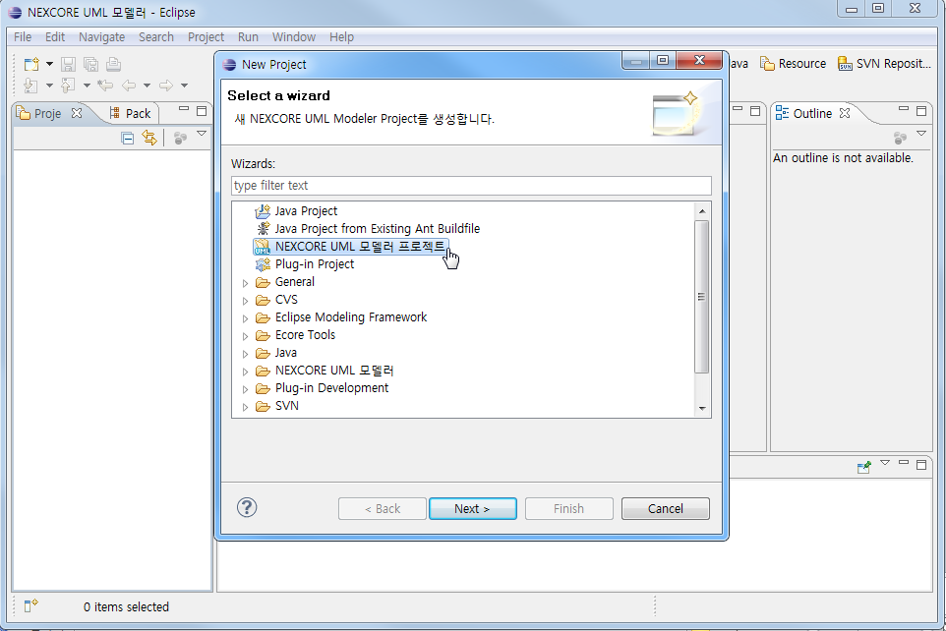
Create UML Project (2/3)

Slide 13
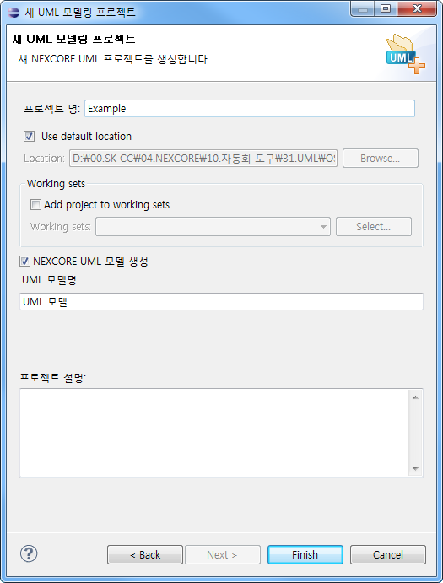
Create UML Project (3/3)
Write
Project Name
Write
Model Name

Slide 14
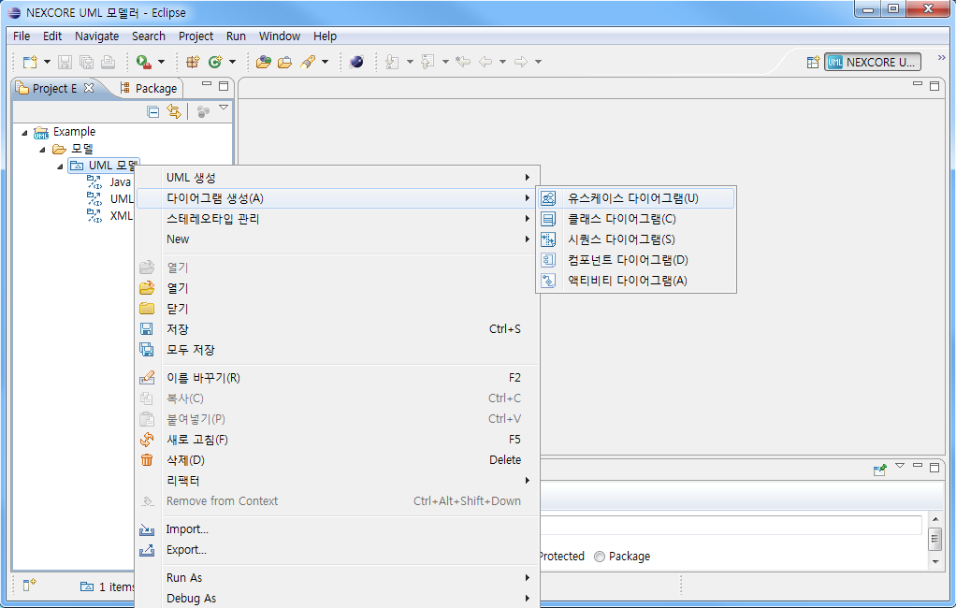
Create UML Diagrams
Right-Click

Slide 15
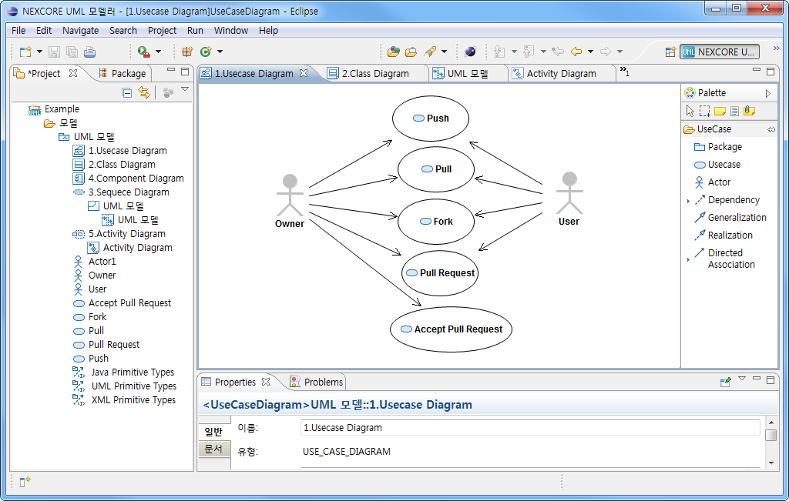
Design UML Diagrams

Slide 16
E.O.D

